Slide 1
Optimization
Lecturer: Erfan Miahi

Slide 2


Slide 3
Lecture Goal
Giving you an overview of Optimization: its algorithms and problems
Advertising Optimization- I have been working, mostly, in this field-since 6 months ago.
So, at The End, you can choose weather you want to pursue this field or not

Slide 4
Btw, there is a huge amount of content in this presentation; so, be ready & sharp

Slide 5
Content
Introduction to Optimization
Applications of Optimization Techniques
Examples & Details of Optimization
Optimization & Modern AI
Intro to Knapsack Problem
Exact methods
Heuristic methods
Metaheuristic methods
References

Slide 6
Introduction to Optimization

Slide 7
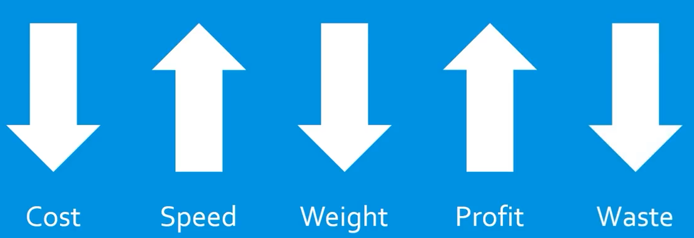
Definition (1/2)
Oxford:
The action of making the best or most effective use of a situation or resource.

Slide 8
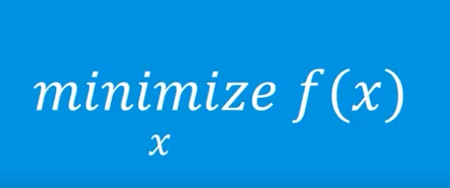
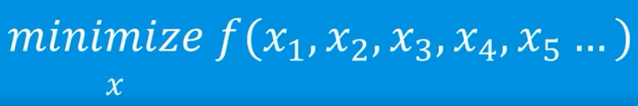
Definition (2/2)
A mathematical technique for finding a maximum or minimum value of a function of several variables subject to a set of constraints.
=>

Slide 9
Applications of Optimization Techniques

Slide 10
Optimization in real world
Mathematical Optimization is a branch of applied mathematics which is useful in many different fields. Here are a few examples:
Manufacturing
Production
Inventory control
Transportation
Scheduling
Networks
Finance
Engineering
Mechanics
Economics
Control engineering
Marketing
Policy Modeling

Slide 11
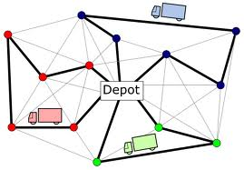
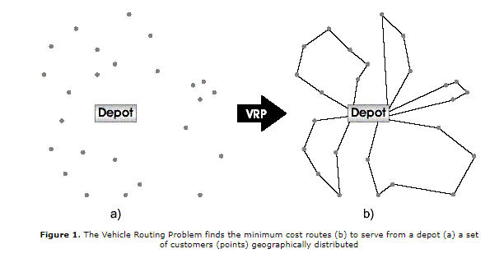
Vehicle Routing Problem
5 Trucks

Slide 12
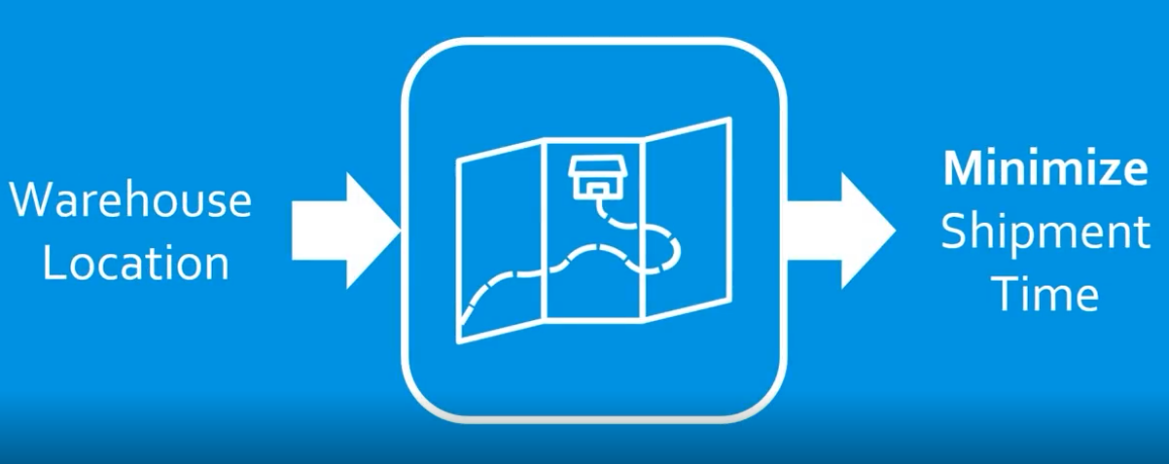
Warehouse Placement

Slide 13
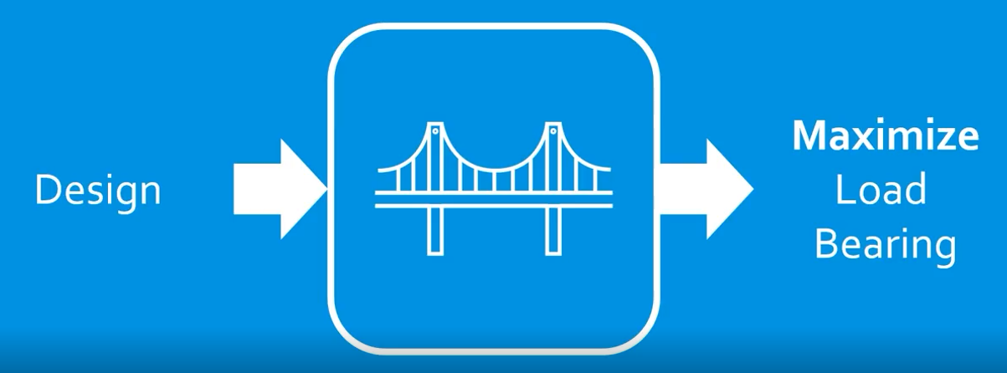
Bridge Construction

Slide 14
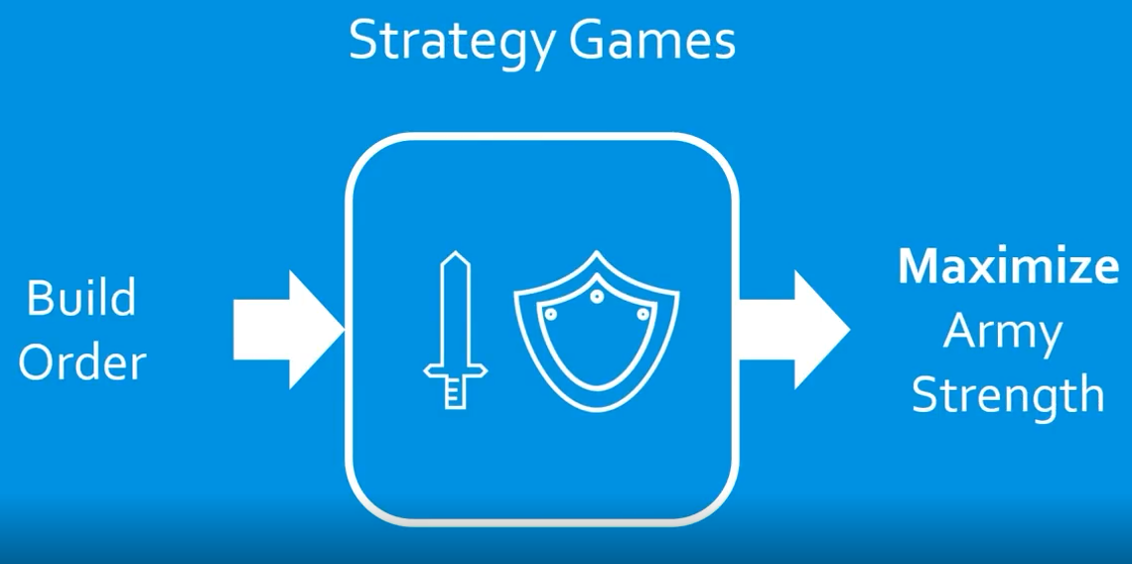
Strategy Games

Slide 15
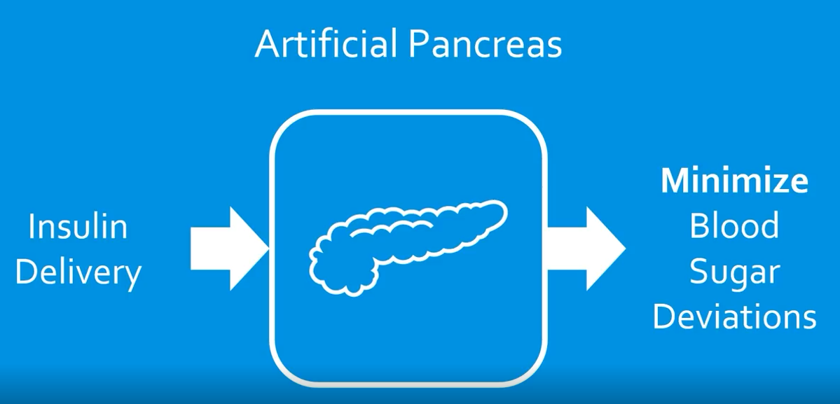
Artificial Pancreas

Slide 16
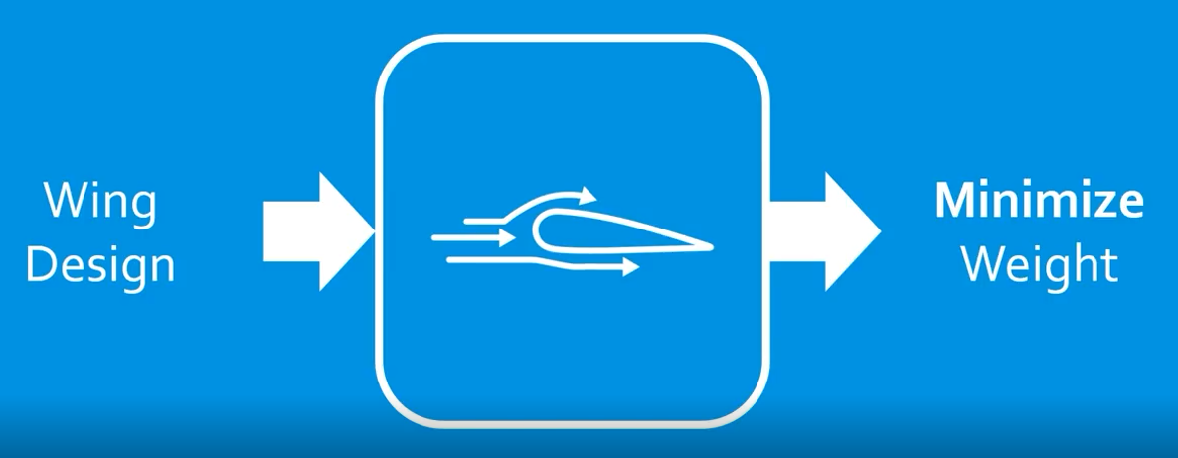
Airplane Design

Slide 17
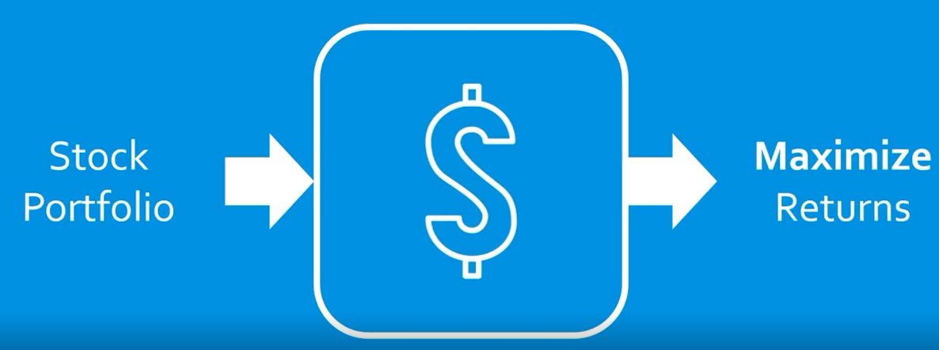
Stock Market

Slide 18
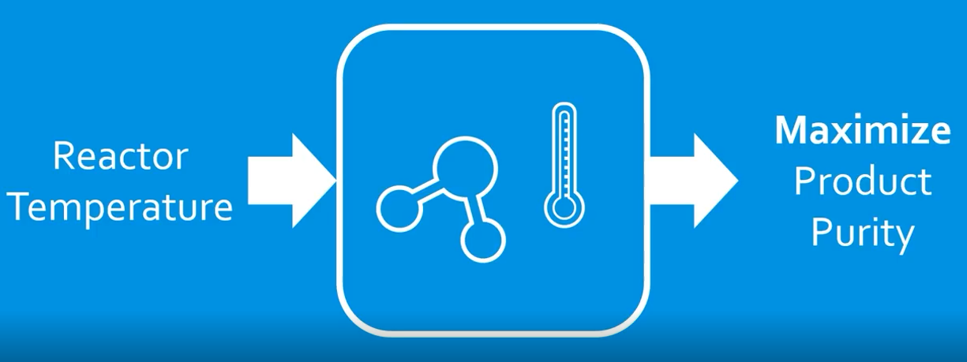
Chemical Reactions

Slide 19
Examples & Details of Optimization

Slide 20
An Almost Complete Definition
Mathematical approach for selection a best decision/action from a set of alternatives
Decision/Actions are modeled as decision variables whose values we are seeking
The set of alternatives is modeled by constraints on the values the decision variables can take
The notion of best is modeled by an objective function (of the decision variables) that needs to be maximized or minimized
An optimization model also has specified problem data to describe the constraints and objective function

Slide 21
Steps to solve an Optimization Problem
Formulating the problem by specifying:
Objective Function
Decision variables
A set of Constraints
Using the following types of algorithms to find a good solution:
Exact methods
Heuristic methods
Metaheuristic methods

Slide 22
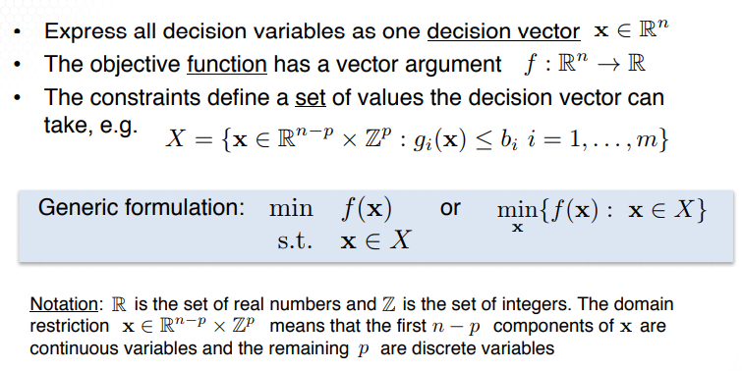
A Generic Formulation

Slide 23

Example: A simple function
Maximization

Slide 24
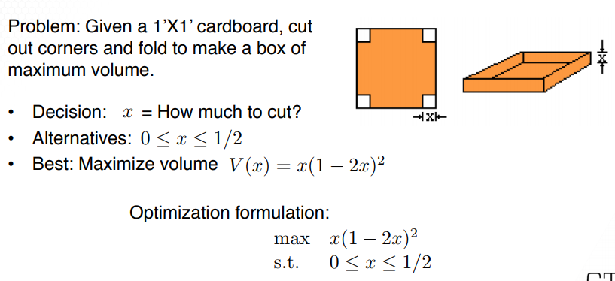
Example: Designing a box
?

Slide 25
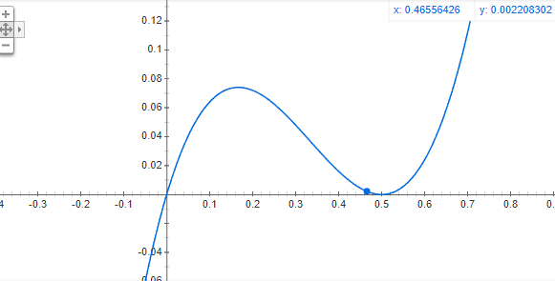
Solution

Slide 26
Optimization & Modern AI

Slide 27
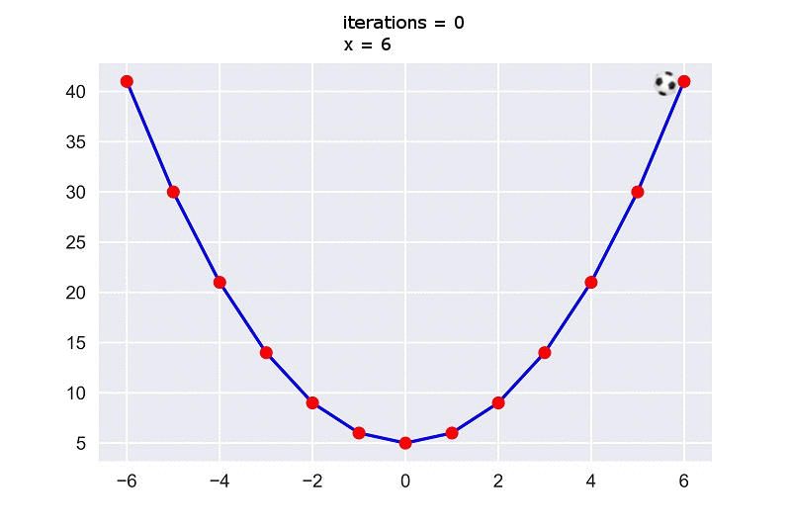
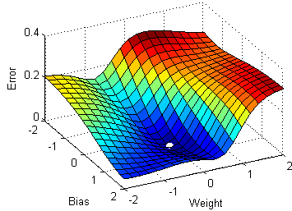
Gradient-based Optimization

Slide 28
Introduction to Knapsack Problem

Slide 29
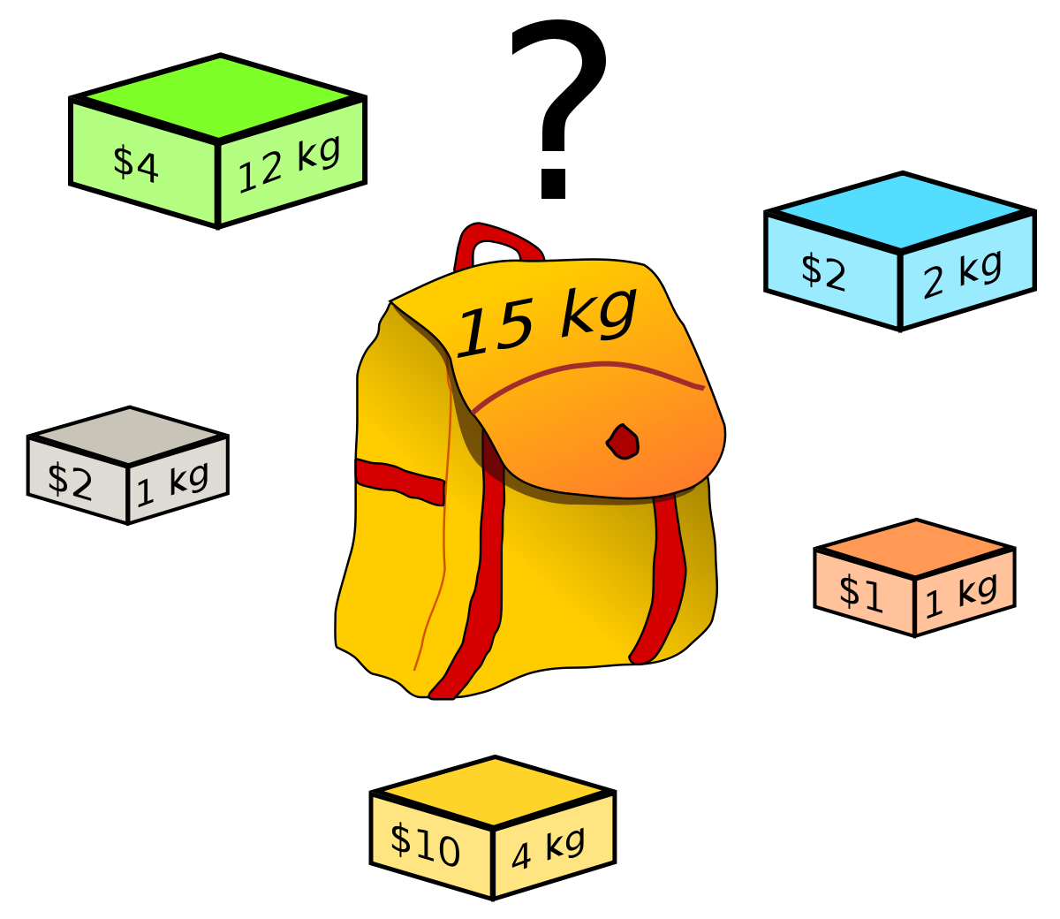
Knapsack Problem Definition
Given a set of items, each with a weight and a value, determine the number of each item to include in a collection so that the total weight is less than or equal to a given limit and the total value is as large as possible.

Slide 30
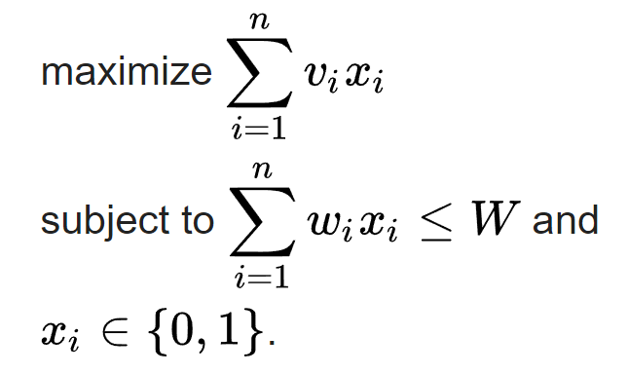
Knapsack Problem Formulation
Given a set of n items numbered from 1 up to n, each with a weight w_{i} and a value v_{i} along with a maximum weight capacity W:
Here x_{i} represents the number of instances of item i to include in the knapsack.

Slide 31

Exciting News!!
Cutting stock problem: the cutting-stock problem is the problem of cutting standard-sized pieces of stock material, such as paper rolls or sheet metal, into pieces of specified sizes while minimizing material wasted.
Packing problems: Packing problems are a class of optimization problems in mathematics that involve attempting to pack objects together into containers.
Calorie optimization

Slide 32
Exact methods

Slide 33

Brute Force -_-
Time Complexity of Knapsack: O(2^{n})

Slide 34
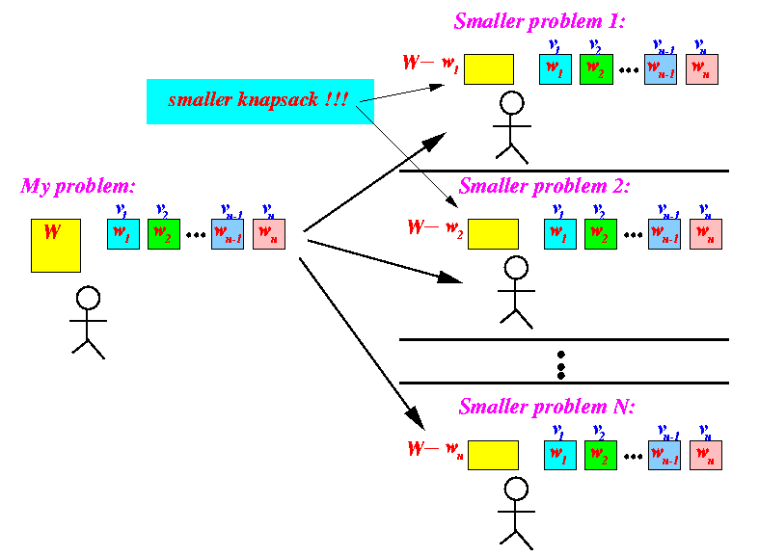
Dynamic Programming *_*

Slide 35
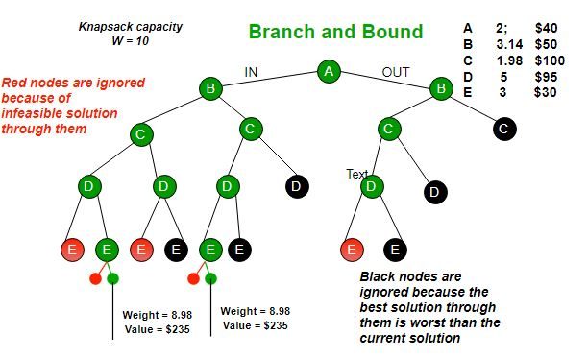
Branch & Bound

Slide 36
& A lot of other Mathematical Optimization Algorithms
Linear Programming
Integer Programming
Mixed Integer Programming
Etc.

Slide 37

Course to watch (1/2)
By Coursera

Slide 38
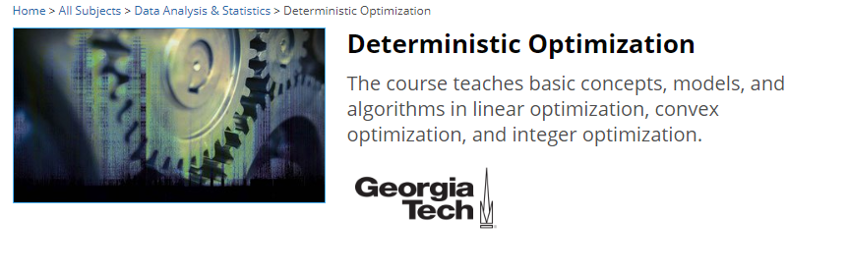
Course to watch (2/2)
By Edx

Slide 39
Heuristic methods

Slide 40
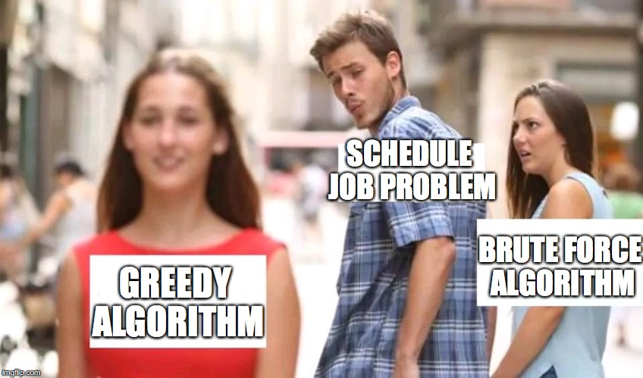
Greedy Algorithm
Solving Knapsack by taking items
with:
Lowest weight
Largest value
Largest Value/Weight
Etc.
Sequentially.

Slide 41
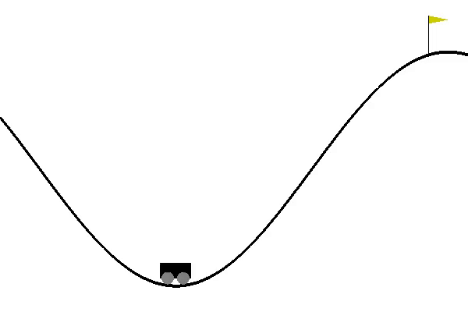
Hill climbing

Slide 42
Metaheuristic methods

Slide 43

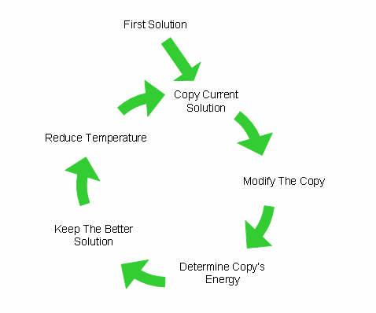

Simulated Annealing

Slide 44
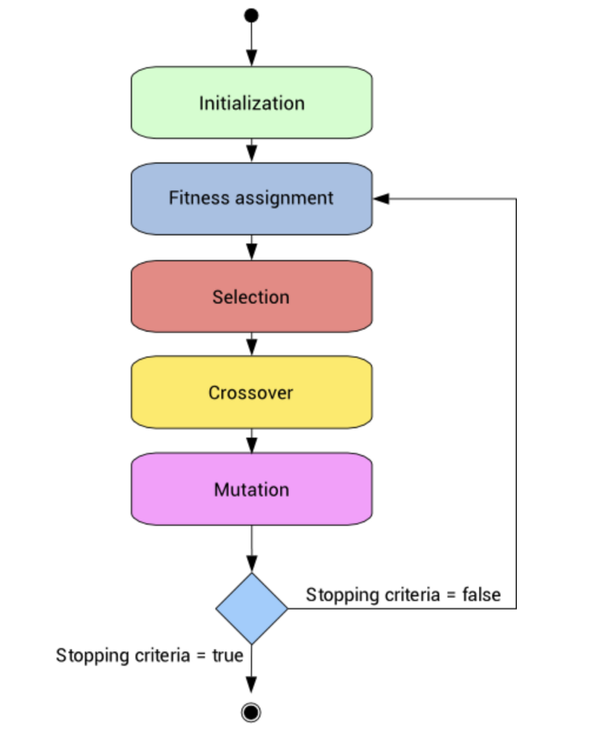
Evolutionary Algorithms

Slide 45
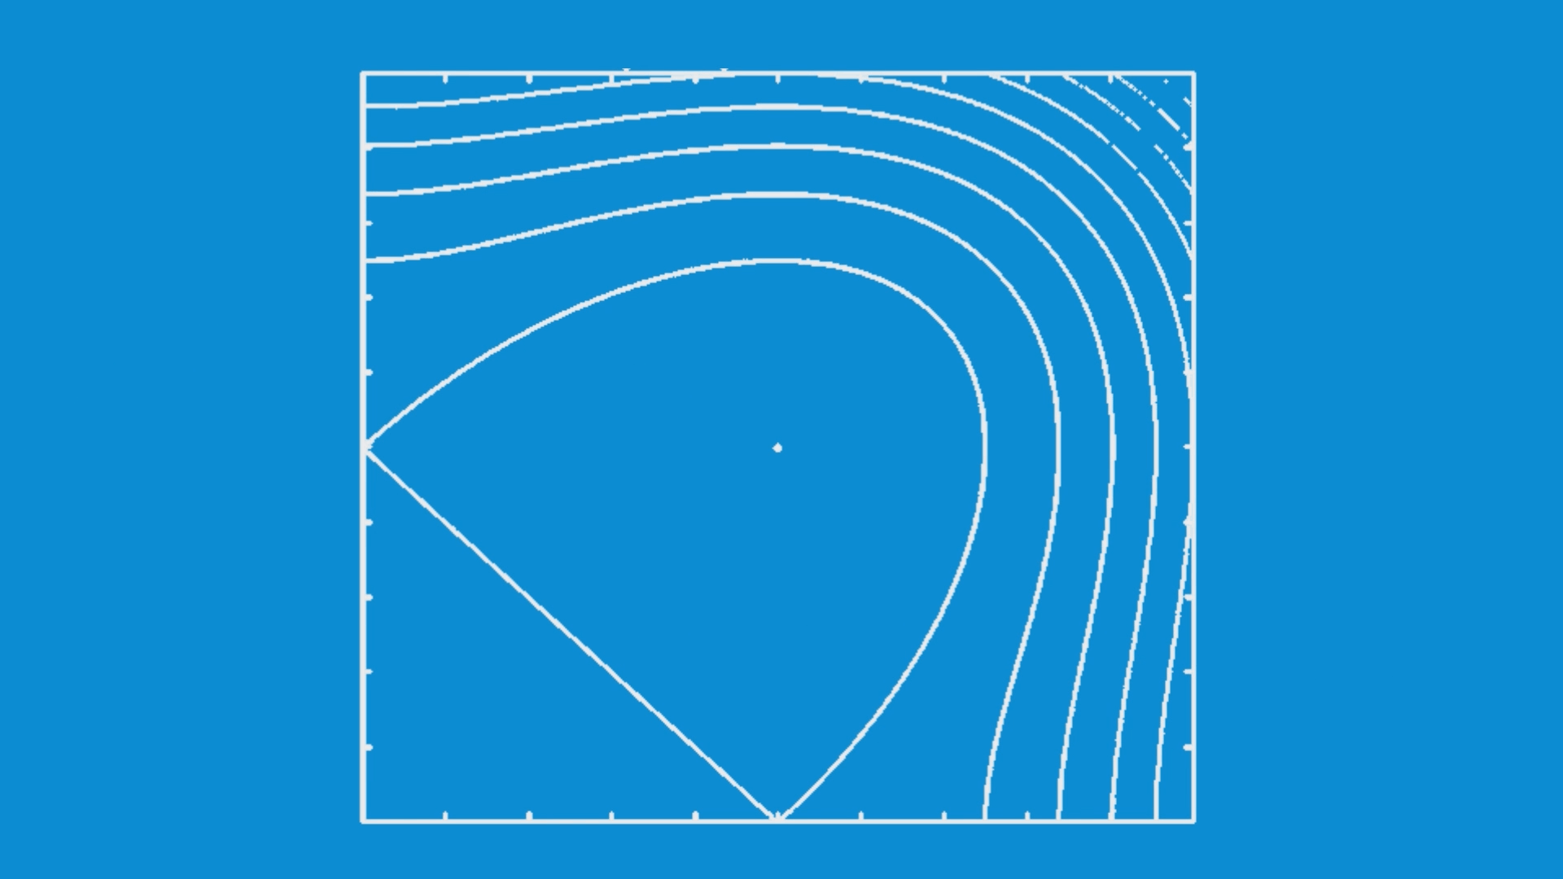
Nelder-Mead

Slide 46
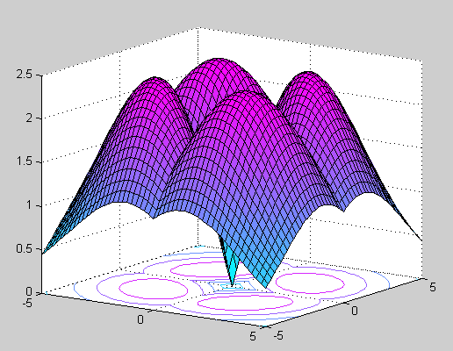
Other Nature-inspired Algorithms
Particle Swarm Optimization (PSO)
Ant Colony Optimization (ACO)
artificial bee colony (ABC)
cuckoo search (CS)
Tabu Search
Harmony Search
Firefly Algorithm
Etc.

Slide 47

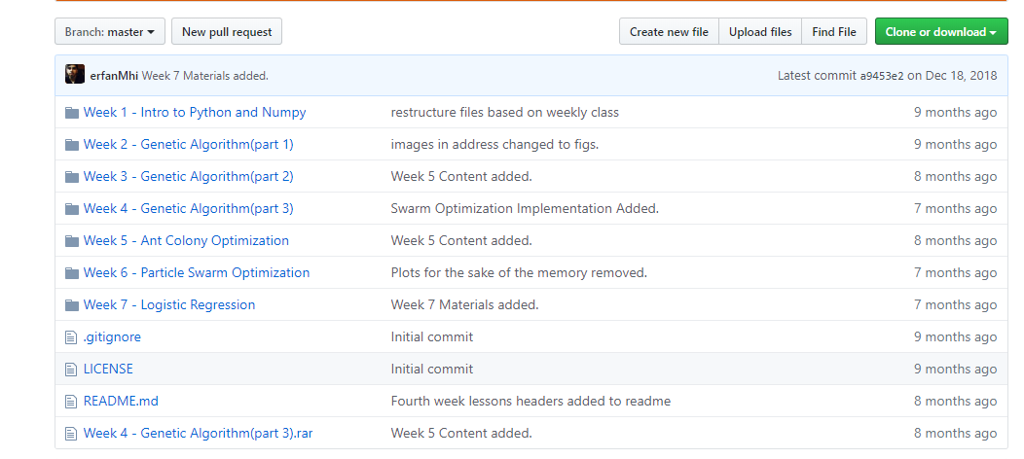
My tutorial on Metaheuristic algorithms

Slide 48
Further Notes
If anybody have an idea about next meeting lecture, let me know
Any question?

Slide 49
Your Turn.

